Slide 1
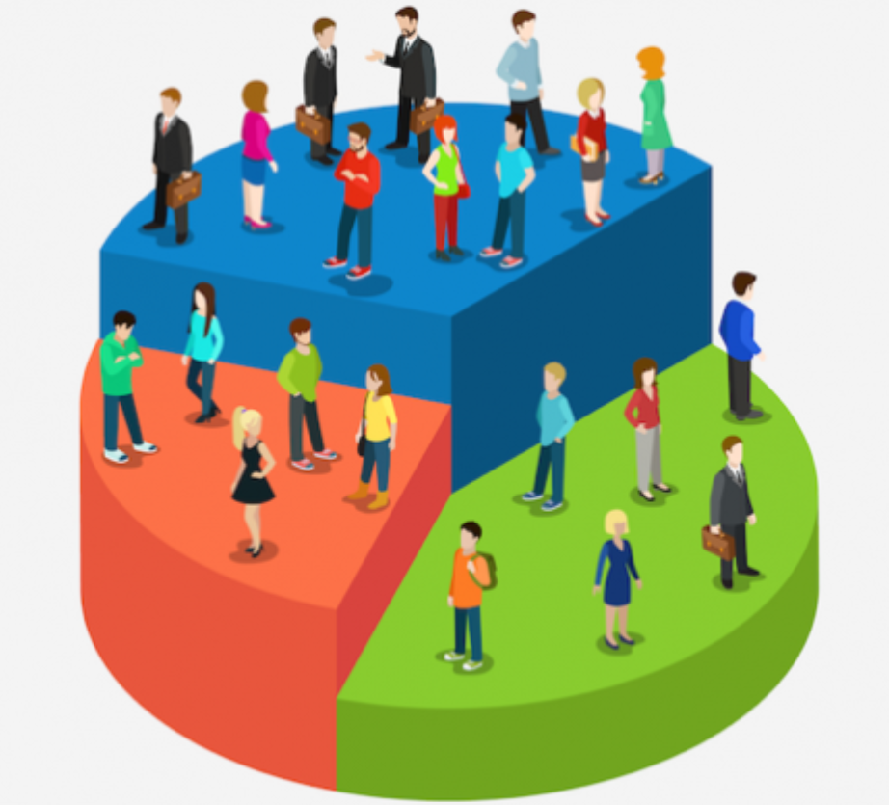
CUSTOMER SEGMENTATION USING RFM ANALYSIS AND CLUSTERING

Slide 2
OUTLINE
Data Understanding
Data Analysis
Data Cleaning and Preparation
Results and Discussions
Objective

Slide 3
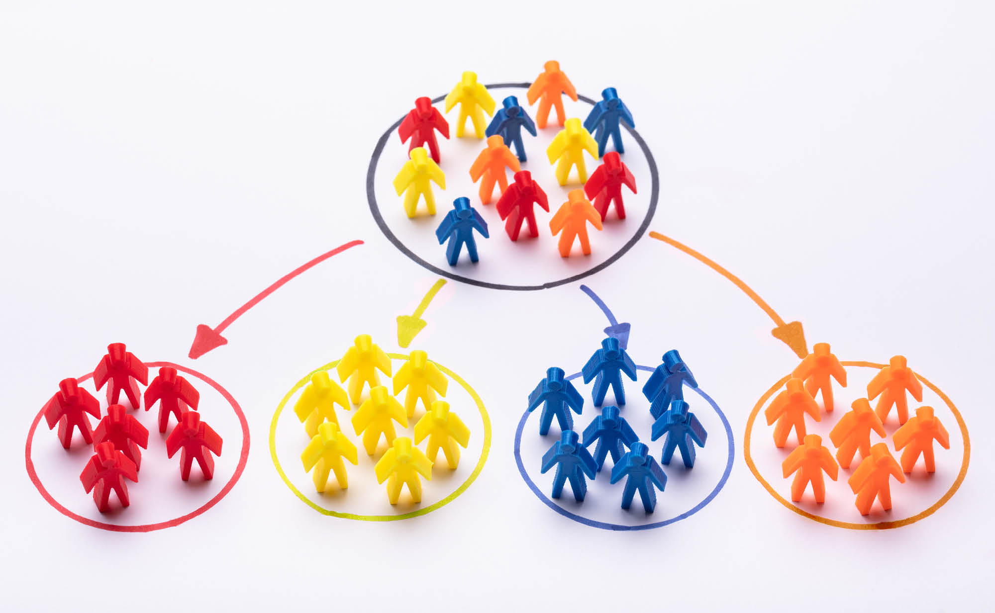
OBJECTIVE
Categorize customers into various clusters to identify customers with similar characteristics that would enhance sales and reduce Customer Churn.

Slide 4
DATA UNDERSTANDING
Name: Online Retail Dataset
Source: UCI Machine Learning Repository
Original dataset has 8 attributes and 541,909 instances.
Column Name | Datatype
InvoiceNo | String
StockCode | String
Description | String
Quantity | Integer
UnitPrice | Float
InvoiceDate | String
CustomerID | Float
Country | String

Slide 5
DATA CLEANING AND PREPARATION
We selected United Kingdom for analysis as the maximum number of records belong to UK

Slide 6
DATA CLEANING AND PREPARATION
Eliminated records where quantities are less than 0.
Eliminated records where unit prices are less than 0.
Restricted the data pertaining to one year as it's better to use a single metric for analysis.
Dropped ‘country’ column.
Removed items with description such as Dotcom Postage, Postage, Manual and Bank charges.
Replaced Blank Customer ID's with '88888’.

Slide 7
Summary of Dataset After Cleaning
DATA CLEANING AND PREPARATION
Number of Transactions | 17,295
Number of Products bought | 3,880
Number of Customers | 3,863
Percentage of NA CustomerID | 0.0%

Slide 8
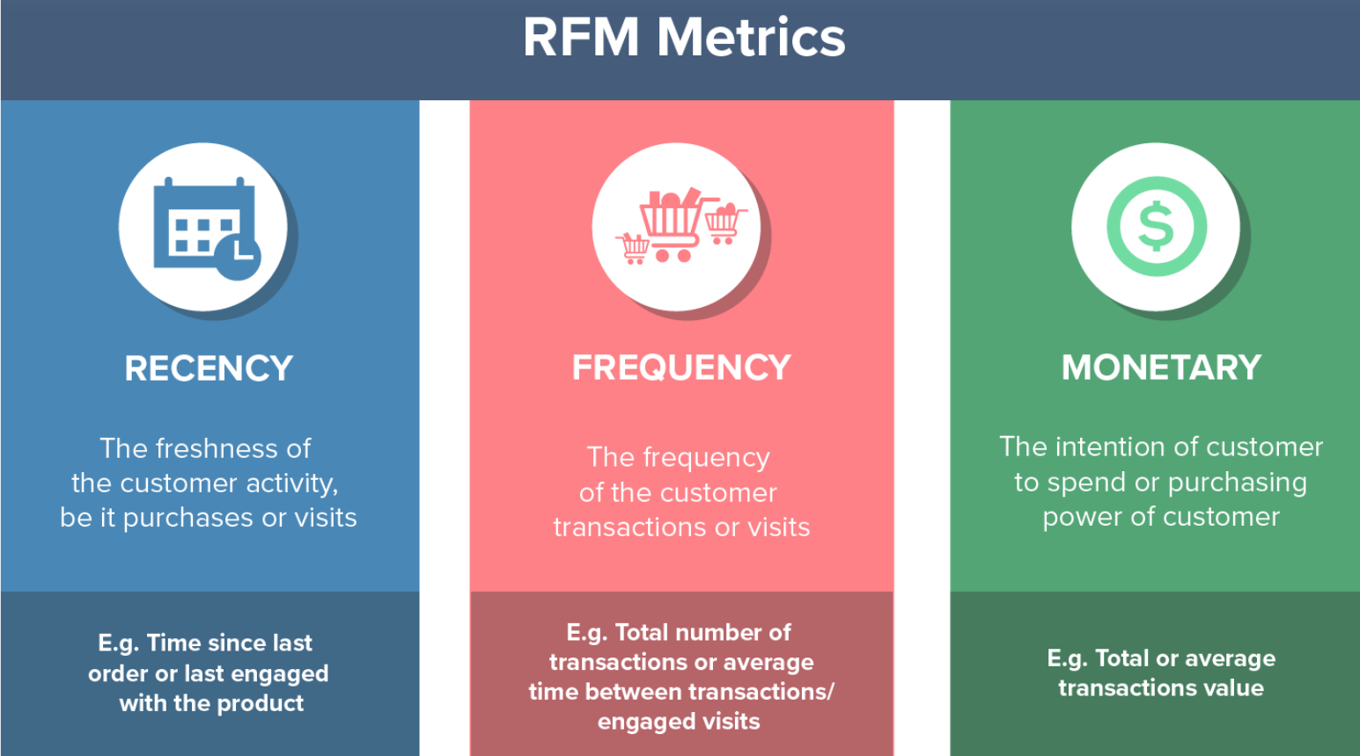
DATA ANALYSIS

Slide 9
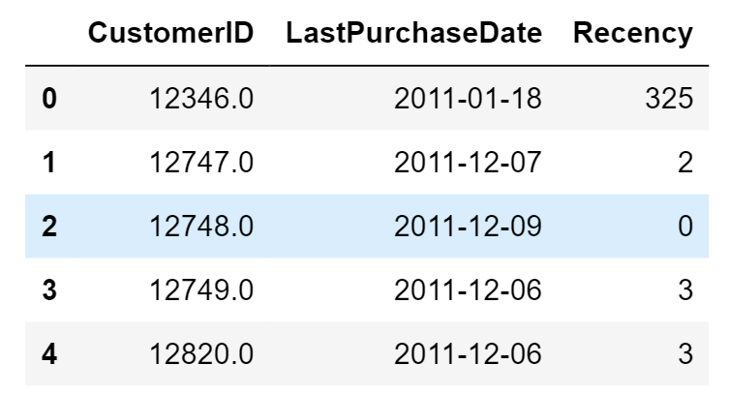
Selected a date point from which we evaluate how many days ago was the customer's last purchase.
Created a new column ‘LastPurchaseDate’ as only date is required.
Grouped customers by CustomerID and check the last date of purchase for each customer ID.
Subtracted “now” (2011-12-09) date from date of purchase to find how many days ago a customer ordered a product.
RECENCY

Slide 10
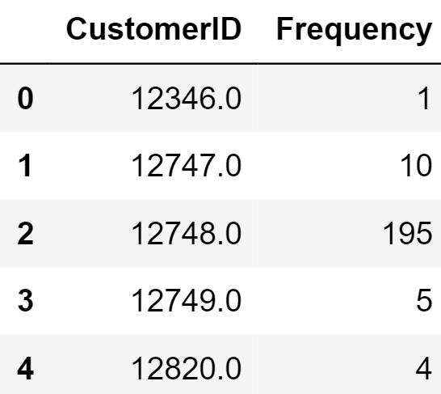
Created a Frequency column that stores invoice numbers registered to the same customer.
Grouped number of invoices for each customer ID to calculate how many times a customer ordered through the year.
FREQUENCY

Slide 11
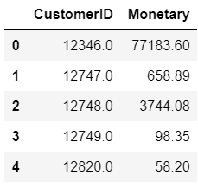
Create a new column named ‘Total Cost’ to have a total price for invoices per customer.
Total Cost= Quantity*Price
Calculate aggregate of total cost and group them by CustomerID to find amount of money spent by each customer.
d
MONETARY

Slide 12
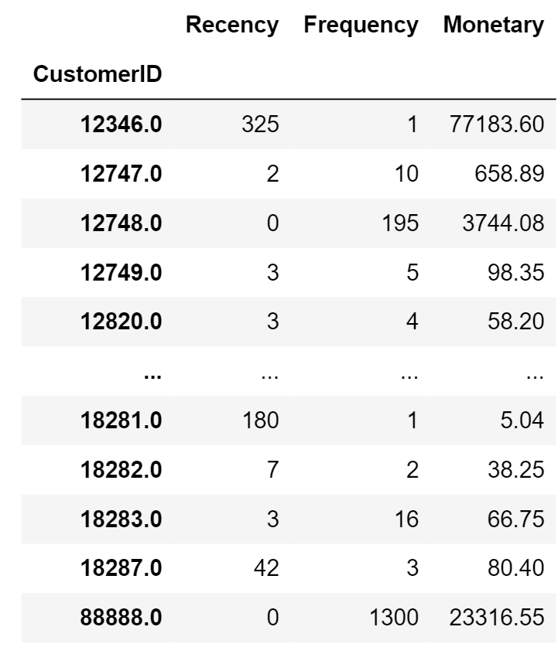
CREATING RFM TABLE WITH SCORES
Merge Recency, Frequency and Monetary columns based on customer ID, to create RFM table.

Slide 13
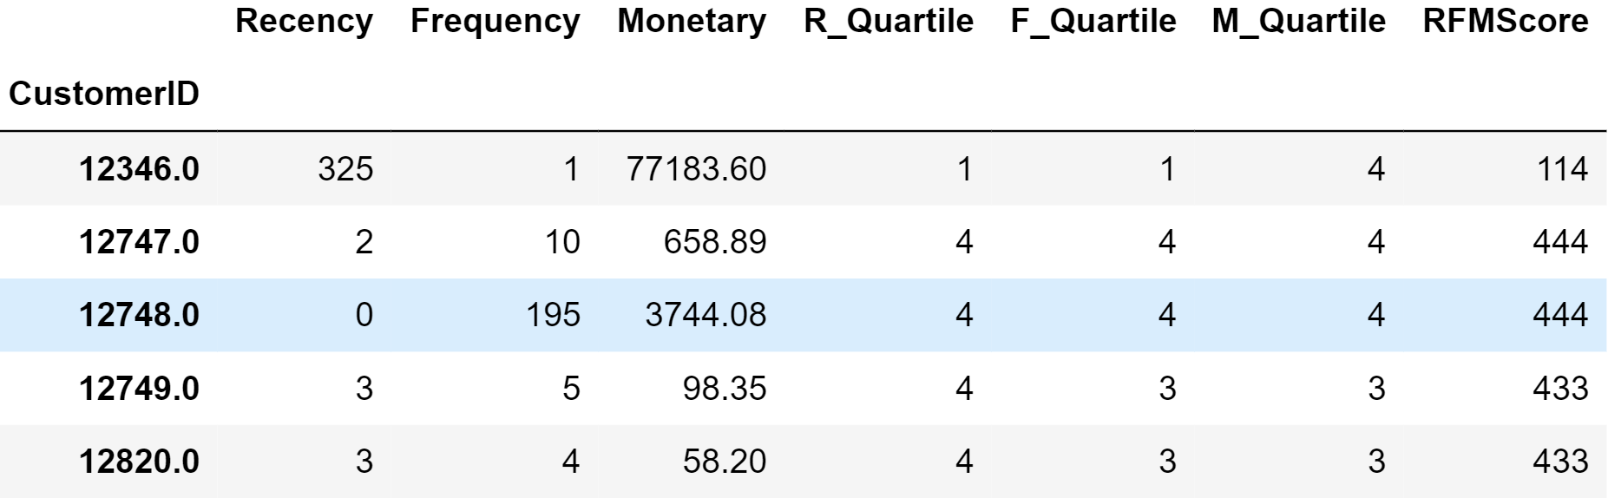
CREATING RFM TABLE WITH SCORES
Assigned scores from 1 to 4 based on Quartiles to Recency, Frequency and Monetary and named those columns as R_Quartile, F_Quartile, M_Quartile.
4 – Best/Highest Value
1 – Worst/Lowest Value
Calculate the final RFM Score by combining individual R_Quartile, F_Quartile, M_Quartile scores for each customer.

Slide 14
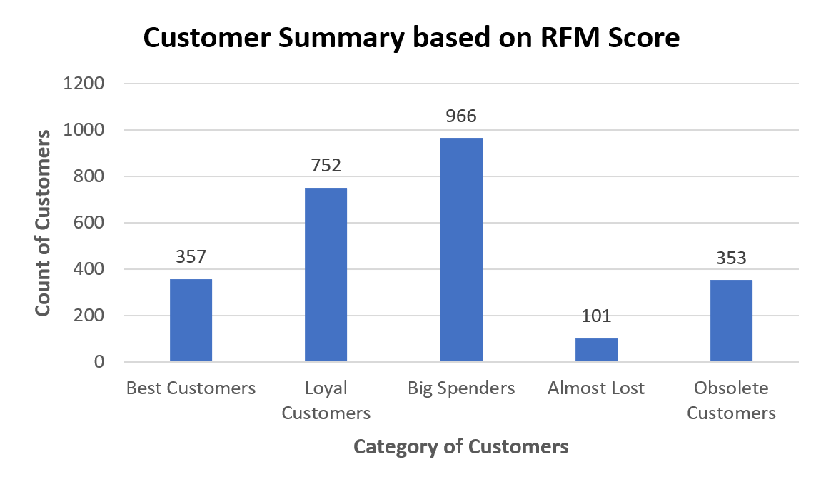
CATEGORISATION OF CUSTOMERS
Best Customers:357 (RFM score 444) Loyal Customers:752 (Fscore 4)
Almost Lost:101 (RFM score 222) Big Spenders:966 (Mscore 4)
Obsolete Customers:353 (RFM score 111)

Slide 15
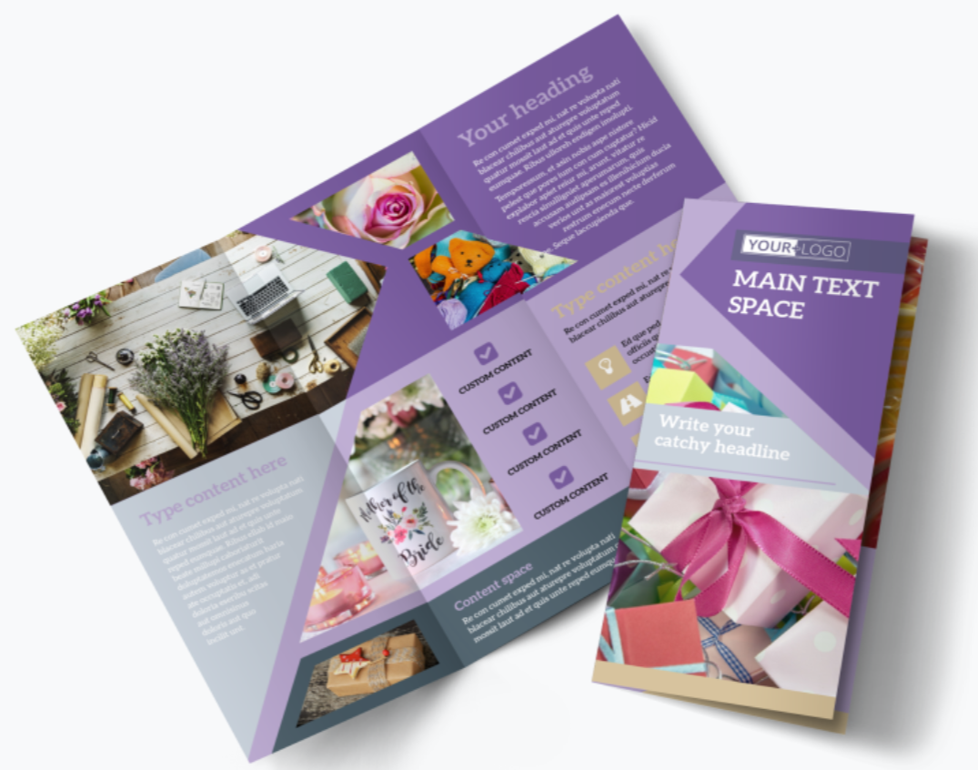

RESULTS AND DISCUSSIONS
222: ALMOST LOST
101 customers haven’t been visiting recently. Bring them back with relevant promotions. They are customers who visit & purchase below average when compared to other level. These customers need direct contact from us. Maybe, we can start by sending our product catalog, most recent purchase from another customer(Customer testimony). Provide them with aggressive price incentives, discounts on bundle purchases, customised products

Slide 16
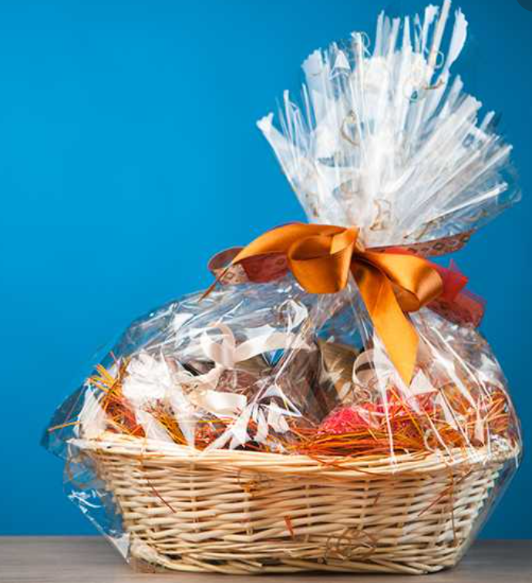

RESULTS AND DISCUSSIONS
F4: MOST LOYAL CUSTOMERS
There are 752 customers who placed an order recently and more often than other customers, but they are not good enough with their purchase if we compare with “potential ”customers. So, we can give more promotion for our product, and make a bundling product. Give them discount when they refer a friend.

Slide 17


RESULTS AND DISCUSSIONS
M4: BIG SPENDERS
We have 966 customers that visit less often than “loyal” customers, but they have good monetary value when compared with “loyal” customers. So, we can reach the M4 customers through promotion for our product, special membership, and recommended product in our retail. Market your most expensive products.

Slide 18



RESULTS AND DISCUSSIONS
111 OBSOLETE CUSTOMERS
111 obsolete customers. We can reach them through promotions, enquire about their daily needs, more action like direct contact through their social media, email, etc., send great customer reviews to them.

Slide 19
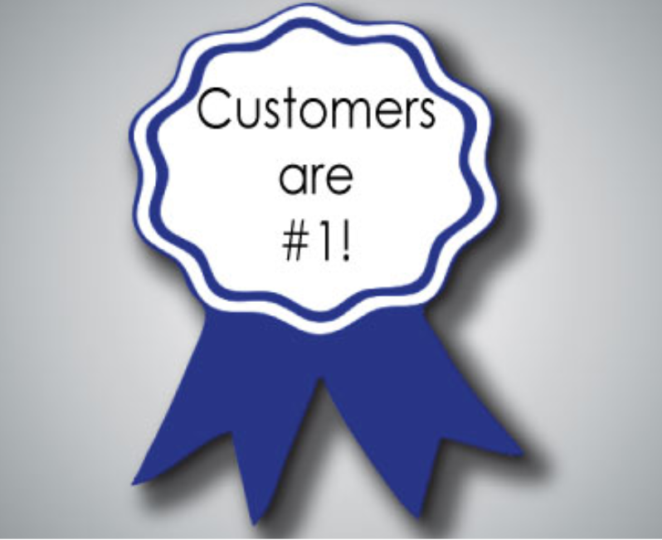

RESULTS AND DISCUSSIONS
444: BEST CUSTOMERS
These 357 customers can be early adopters to new products.Give them reward points for each transaction and give priority level after that. These are our best customers and we must keep it up! Ask them to Refer a friend, market the best products.

Slide 20
